Slide 1
Cloud-Based Analysis of Music Aesthetic Trends
CSC1142 Cloud Technologies
Do Public and Professional Tastes Align?
MCM1 - Data Analytics
Submitted By:
A00049618 | A00048674
Megha Kanojia | Shubin Li
megha.kanojia2@mail.dcu.ie | shubin.li2@mail.dcu.ie

Slide 2
The problem and motivation
Music Industry
Solution
Result
Exploring the gap between expert aesthetics and public preferences.
An end-to-end cloud-based pipeline for data processing and analysis.
A comparison across three groups: Grammy, Spotify Top 100, and General Spotify.

Slide 3
Technologies Used
PySpark | The core ETL (Extract, Transform, Load) engine
Google Colab + Drive | Infrastructure and Storage
Parquet | Optimized and Reproducible Intermediate Storage
Pandas + Seaborn + ipywidgets | Analytics & Visualization

Slide 4
Pipeline Overview
Data Extraction
Cleaning & Normalization
Entity Matching
Ranking & Filtering
Parquet Output
Visualization

Slide 5
Grammy Data Processing
Filtered for Record of the Year entries from 2000–2023
Applied regex cleaning and case normalization
Performed automatic and manual entity matching
Output: grammy_group_parquet

Slide 6
Spotify Data Processing
1.15 million records
Multiline fields and embedded quotes caused parsing errors
Handled using Spark’s special parsing options
After cleaning, the data could be correctly partitioned by year
Output: spotify_group_parquet

Slide 7
Extracting Spotify Top 100
Partitioning + sorting + windowing
2,400 top-ranked tracks
Performed a horizontal merge with the Grammy group
Output: spotify_group_parquet

Slide 8
Interactive Visuals

Slide 9
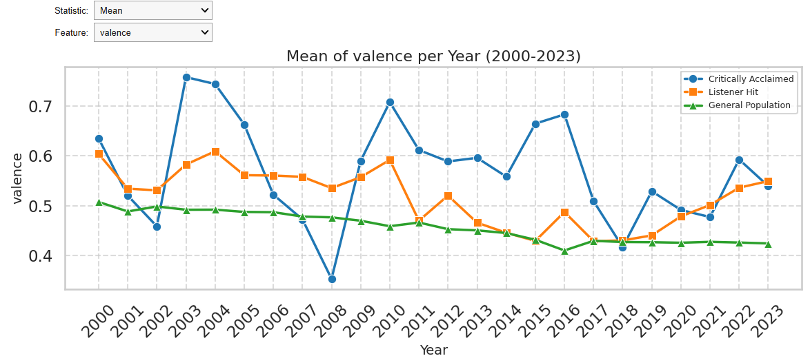
Line chart
Line charts showing 23-year trends
14 audio features
Switchable Mean / Median
Three groups compared: Critically Acclaimed, Listener Hits (Top100), General Population

Slide 10
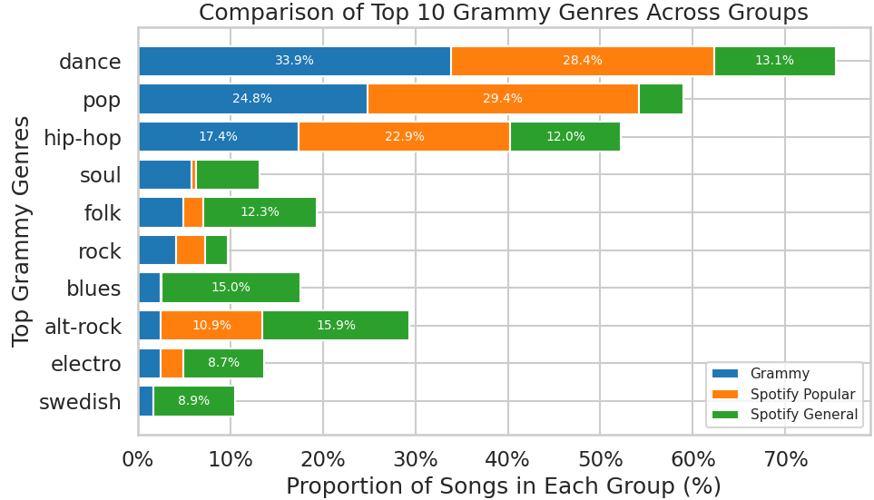
Stacked bar chart
Top 10 genres horizontal stacked bar chart
Three groups compared

Slide 11
Findings
There is a gap between expert aesthetics and public preferences.
The interactive analysis tool can be extended to other music platforms.
The cloud-based pipeline is reusable.

Slide 12
Thank you

